Slide 1
US companies’ stocks and ADR are traded in New York Stock Exchange (NYSE).
Indexes for specific stocks are also published.
Ex. NASD (NASDAQ)
USA
9:30
16:00
23:45
6:00
9:30
16:00
A
B
C
D
9h30m ahead
α
β
IND
19:00
1:30
9:15
15:30
19:00
1:30
Indian companies’ stocks are traded in National Stock Exchange of India (NSE).
Ex. INFY (Infosys), TATA MOTORORS
ICICI BANK

Slide 2
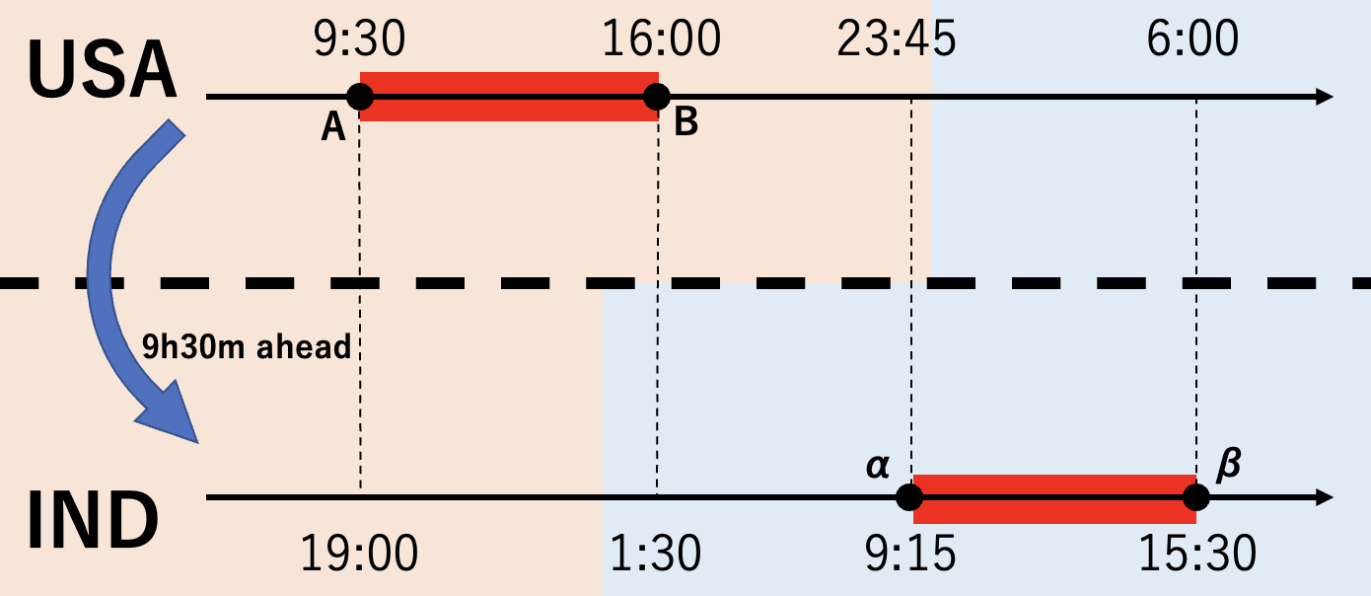
Data Frame Structure
Close price – Open price in NSE (β-α)
1 (Close – Open > 0) or 0 (Close – Open < 0)
Previous business day’s data
nse_ Close-Open _sign | nyse_ preOpen | nyse_ preHigh | nyse_ preLow | nyse_ preClose | nyse_ preVolume | nasd_ preOpen | nasd_ preHigh | nasd_ preLow | nasd_ preClose
1 | 7.002500 | 7.112500 | 7.001250 | 7.095000 | 11443200 | 2294.40991 | 2311.14990 | 2294.40991 | 2308.41992
0 | 7.087500 | 7.125000 | 7.048750 | 7.122500 | 8181600 | 2307.27002 | 2313.72998 | 2295.62011 | 2308.70996
… | … | … | … | … | … | … | … | … | …
NYSE data:
Open price (A)
High price (between A and B)
Low price (between A and B)
Close price (B)
Volume (between A and B)
NASDAQ data:
Open price (A)
High price (between A and B)
Low price (between A and B)
Close price (B)

Slide 3
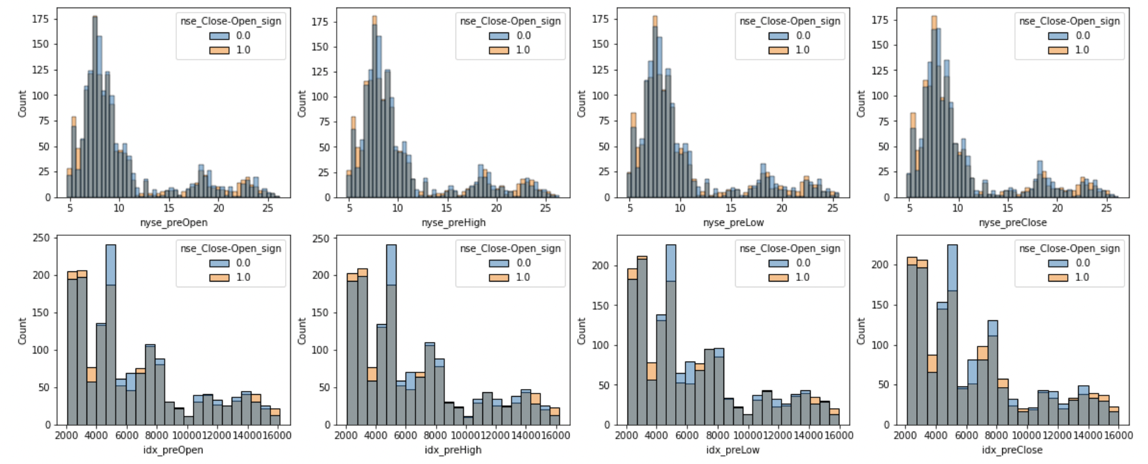
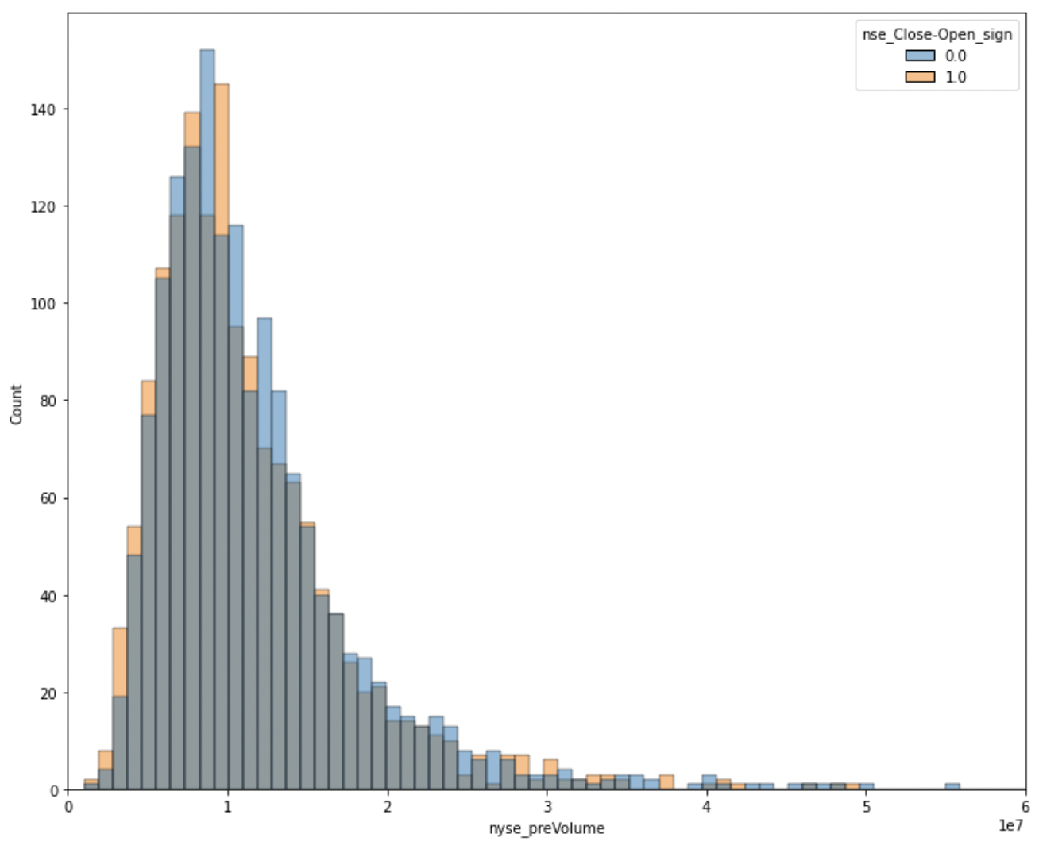
EDA – Histogram (1)
Histograms of previous day’s NYSE and NASDAQ data
There is no obvious difference between nse_Close-Open_sign = 0 and 1
NYSE
NASD
NYSE Volume
Open price
High price
Low price
Close price

Slide 4
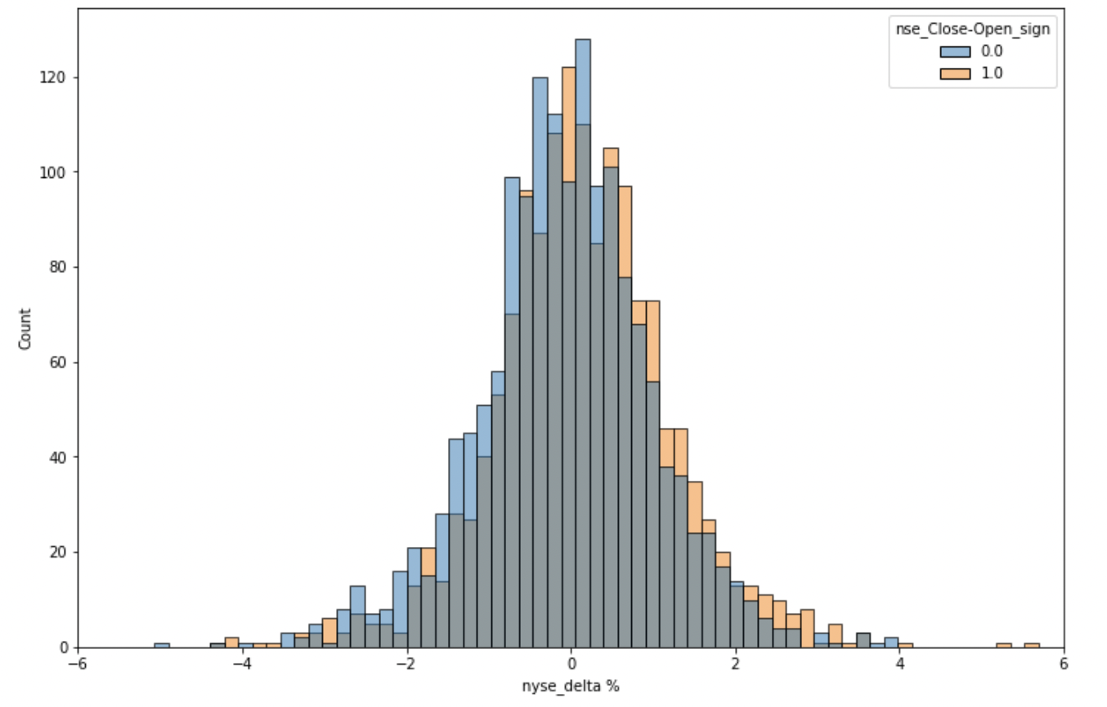
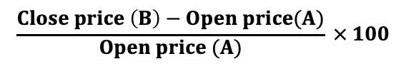
EDA – Histogram (2)
Histogram of the percentage change in the close price relative to open price in NYSE
The distributions of nse_Close-Open_sign = 1 and 0 are almost identical but appear to be very slightly off.
$$\frac{Close price \left(B\right)−Open price(A)}{Open price (A)} × 100$$

Slide 5
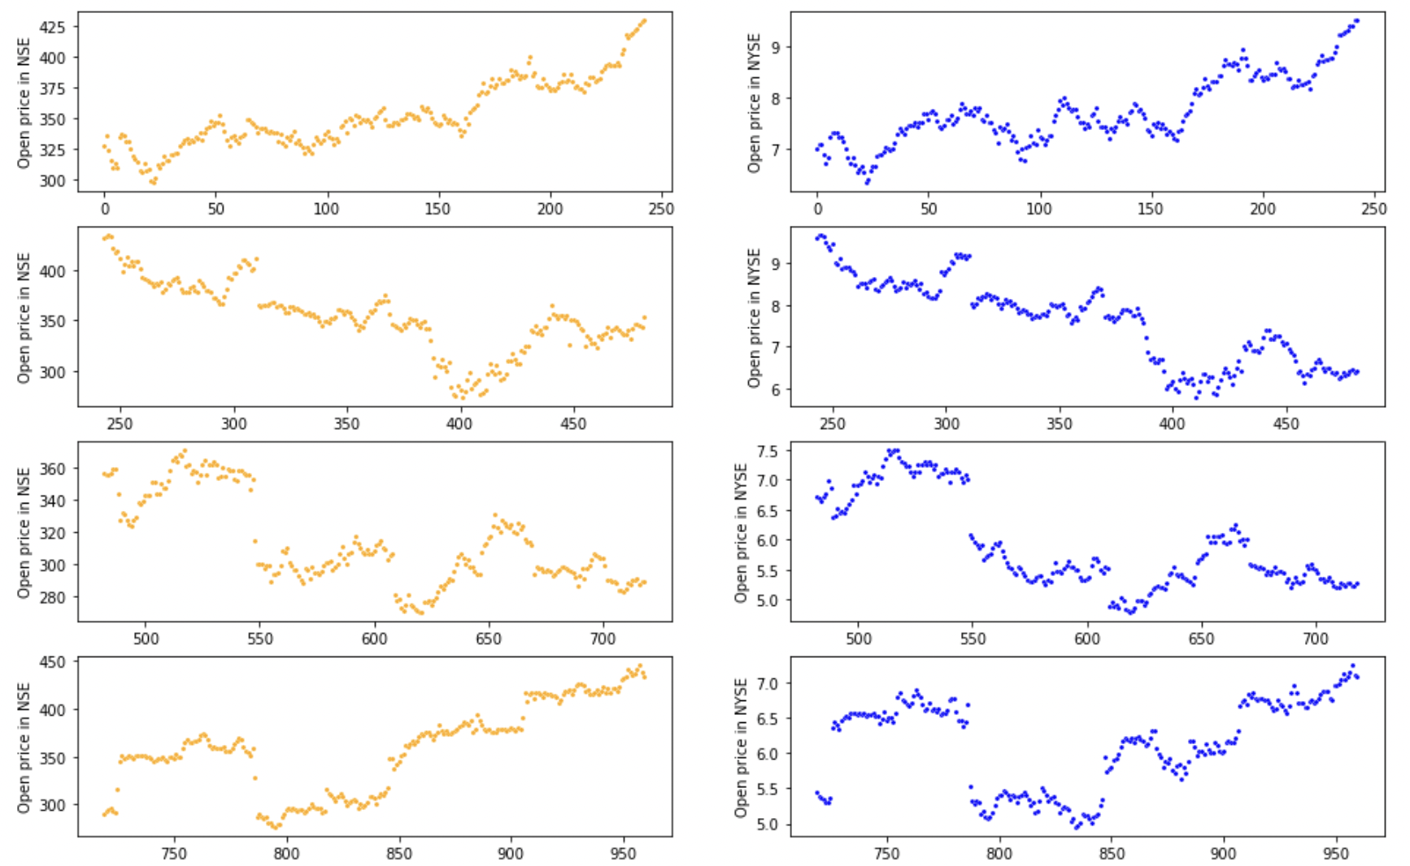
EDA – Time Series Change of Open price (1)
Open price changes in NSE and NYSE are similar
NSE
NYSE
2010
2011
2012
2013

Slide 6
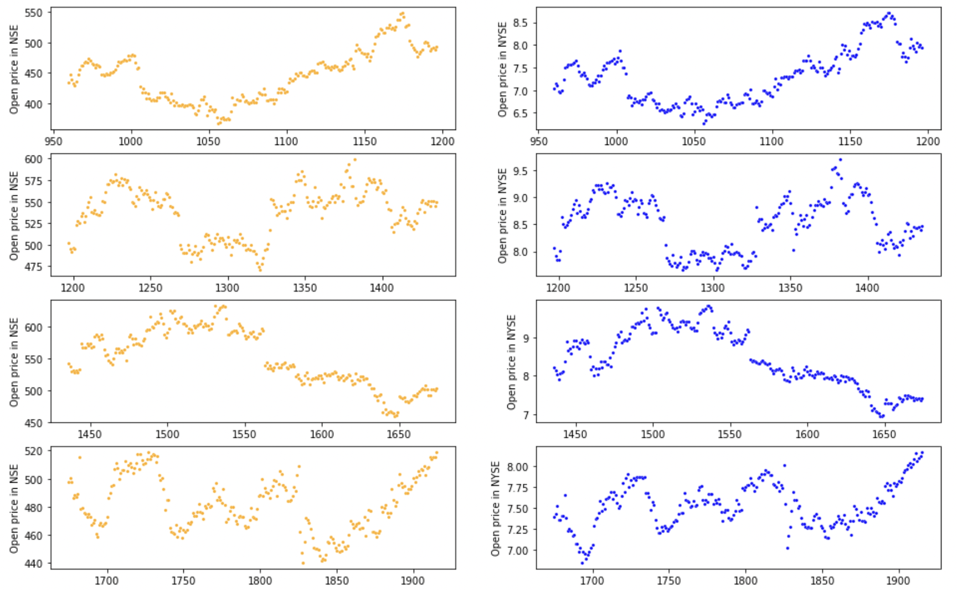
EDA – Time Series Change of Open price (2)
Open price changes in NSE and NYSE are similar
NSE
NYSE
2014
2015
2016
2017

Slide 7
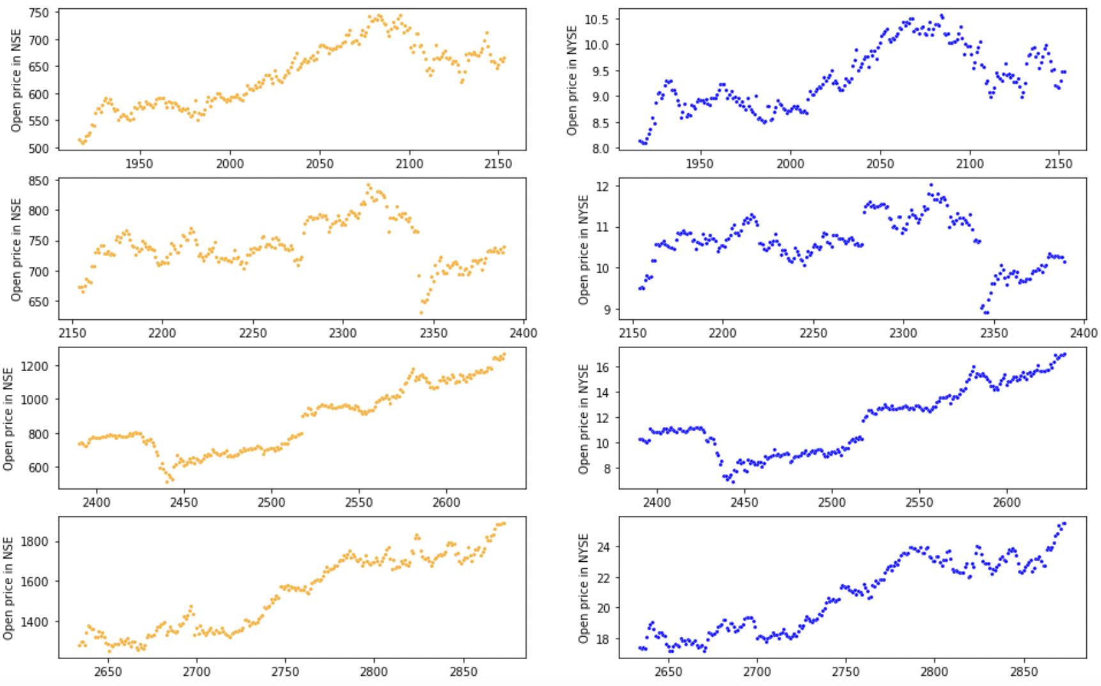
EDA – Time Series Change of Open price (3)
Open price changes in NSE and NYSE are similar
NSE
NYSE
2018
2019
2020
2021

Slide 8
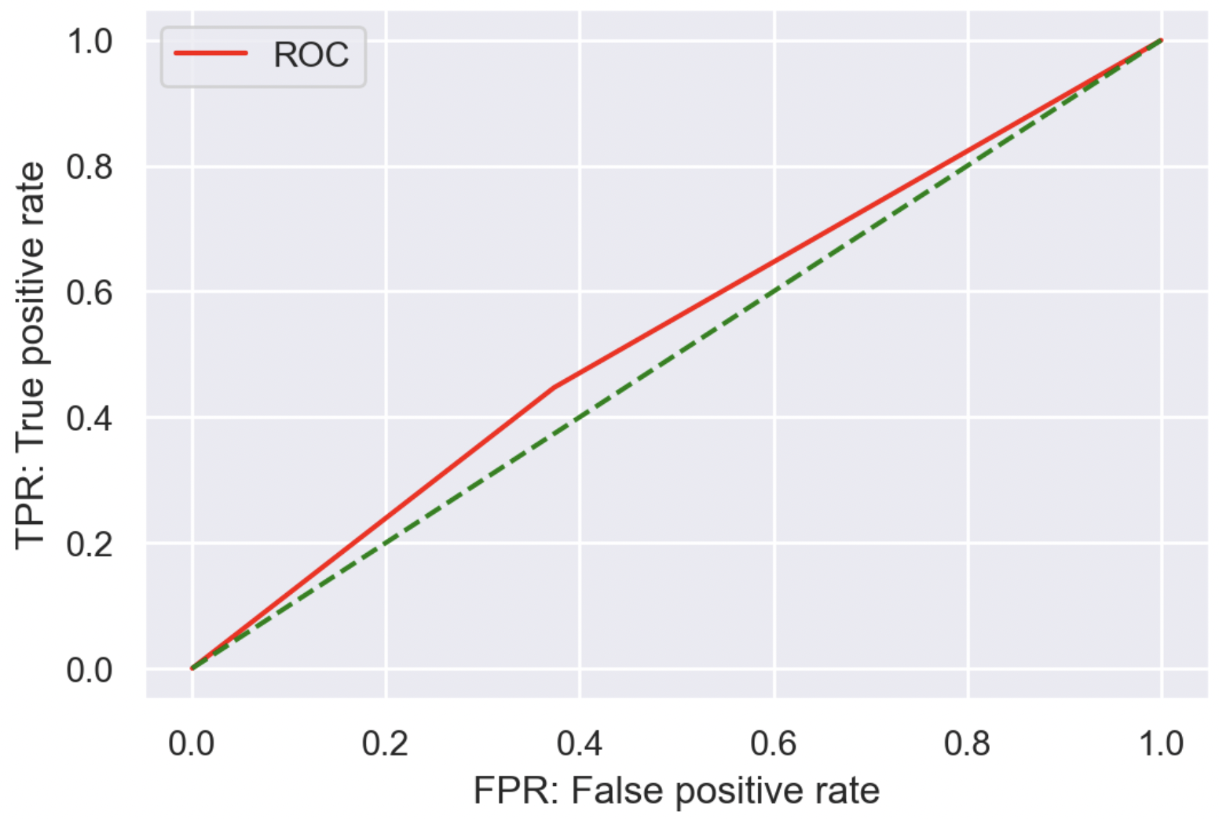
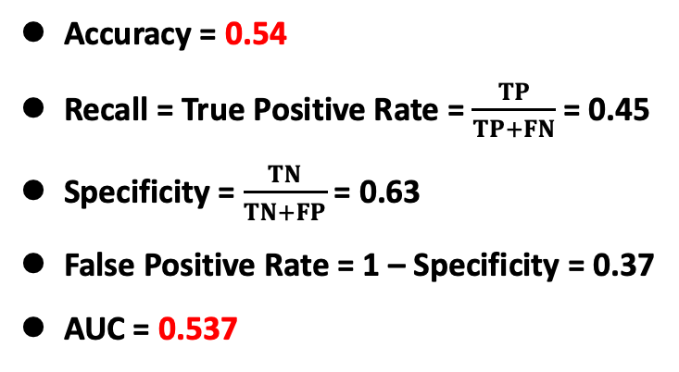
Model 1 – Logistic Regression
Split the data into training (70%) and testing(30%)
Predict whether (Close – Open) > 0 or (Close – Open) < 0 in NSE using the previous day's NYSE data
Predict
 | 0 | 1
0 | 297 | 177
1 | 250 | 202
Actual
Accuracy = 0.54
Recall = True Positive Rate = $\frac{TP}{TP+FN}$ = 0.45
Specificity = $\frac{TN}{TN+FP}$ = 0.63
False Positive Rate = 1 – Specificity = 0.37
AUC = 0.537

Slide 9
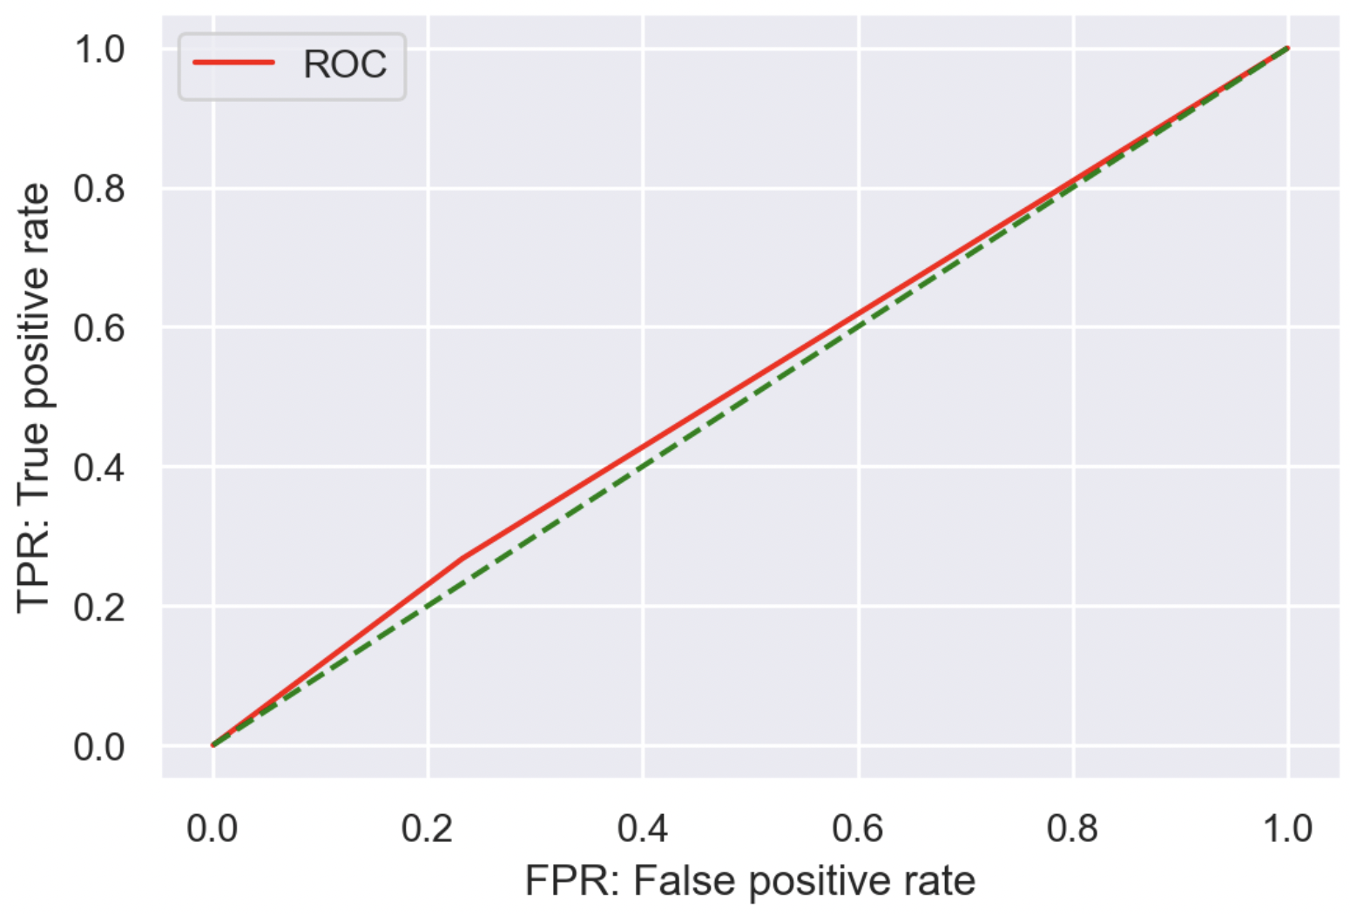
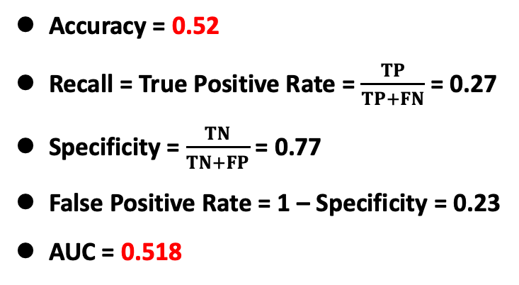
Model 2 – Random Forest
Split the data into training (70%) and testing(30%)
Predict whether (Close – Open) > 0 or (Close – Open) < 0 in NSE using the previous day's NYSE data
Predict
 | 0 | 1
0 | 364 | 110
1 | 331 | 121
Actual
Accuracy = 0.52
Recall = True Positive Rate = $\frac{TP}{TP+FN}$ = 0.27
Specificity = $\frac{TN}{TN+FP}$ = 0.77
False Positive Rate = 1 – Specificity = 0.23
AUC = 0.518

Slide 10
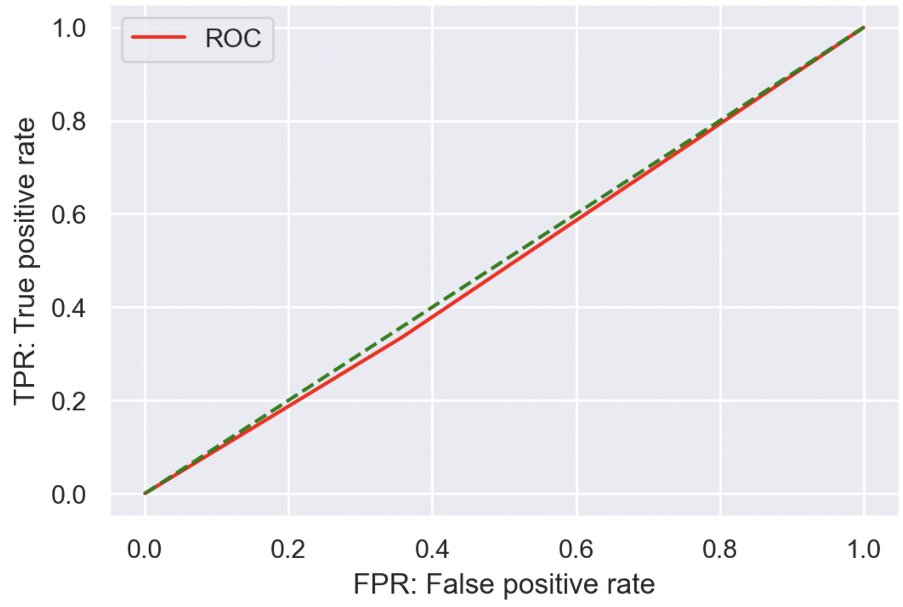

Model 3 – Boosting
Split the data into training (70%) and testing(30%)
Predict whether (Close – Open) > 0 or (Close – Open) < 0 in NSE using the previous day's NYSE data
Predict
 | 0 | 1
0 | 254 | 142
1 | 249 | 126
Actual
Accuracy = 0.49
Recall = True Positive Rate = $\frac{TP}{TP+FN}$ = 0.34
Specificity = $\frac{TN}{TN+FP}$ = 0.64
False Positive Rate = 1 – Specificity = 0.36
AUC = 0.489

Slide 11
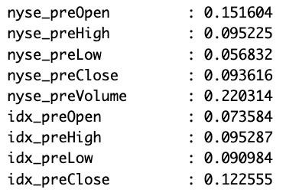
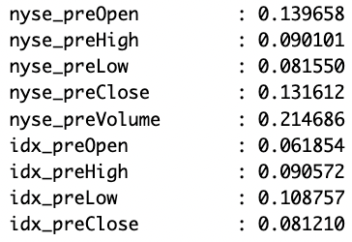
Feature Selection
Feature importance from Random Forest
Feature importance from Boosting
“nyse_preVolume” and “nyse_preOpen” have high importance in both Random Forest and Boosting
“nyse_preClose” has also relatively high importance
→ Create models using nyse_preVolume, nyse_preOpen, and nyse_preClose

Slide 12
Feature reduced models
Results:
Logistic regression → Accuracy = 0.54, AUC = 0.539
Random Forest → Accuracy = 0.51, AUC = 0.504
Boosting → Accuracy = 0.51, AUC = 0.513
Accuracy of each model:
 | Logistic regression | Random Forest | Boosting
Full model | Accuracy: 0.539 AUC: 0.537 | Accuracy: 0.524 AUC: 0.518 | Accuracy: 0.493 AUC: 0.489
Feature reduced model | Accuracy: 0.542 AUC: 0.539 | Accuracy: 0.510 AUC: 0.504 | Accuracy: 0.514 AUC: 0.513

Slide 13
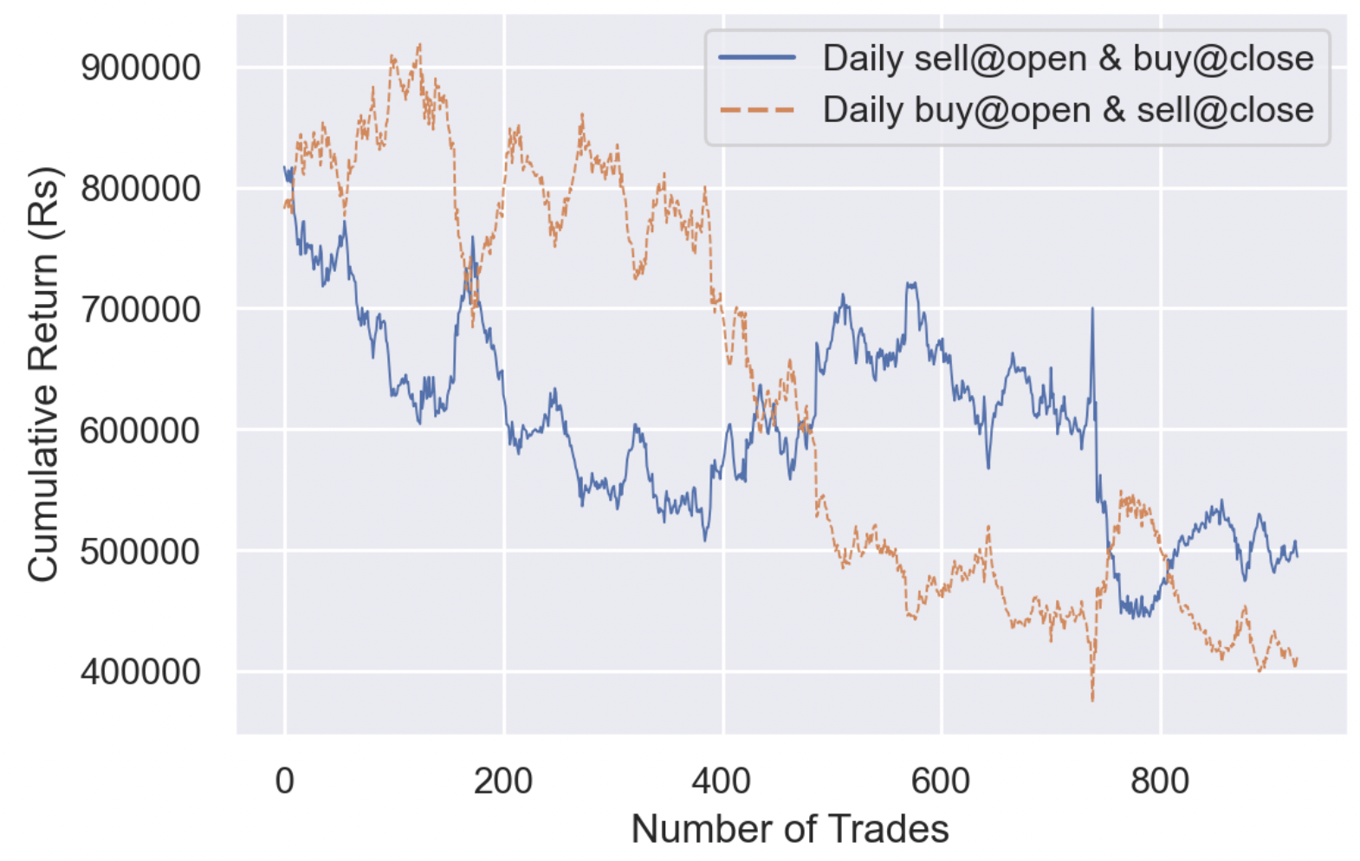
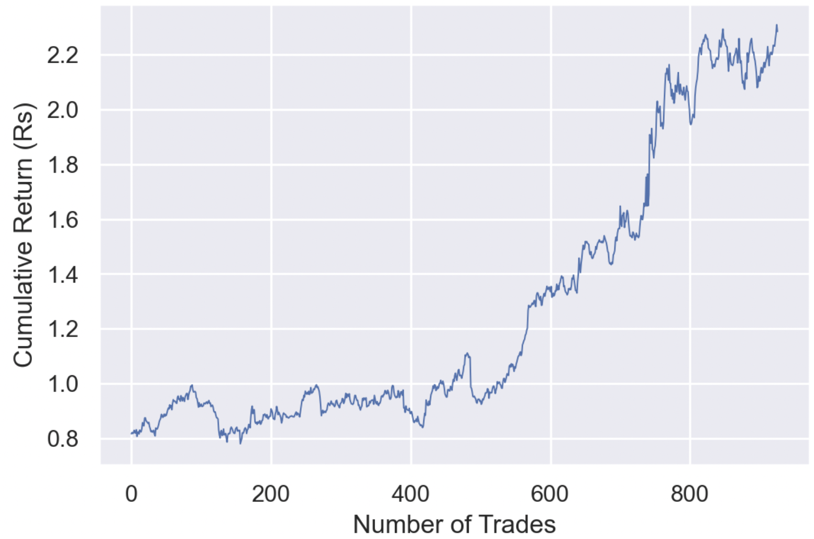
Simulation
Simulate day trading using the feature reduced Logistic regression model and test data
If the model predicts that Close > Open, buy the stocks at NSE open and sell the stocks at NSE close
If the model predicts that Close < Open, sell the stocks at NSE open and buy the stocks at NSE close
Calculate the cumulative return for a capital of 800,000 INR
Blind trading
(unit: 1e6)
Trading using the model

